Slide 1

1
| 2010 01 08 | CONFIDENTIAL

Slide 2
Midi Techno Git: Distributed Version Control System
Jean Lalande
CTS
2013 03 05

Slide 3
History of Version Control

Slide 4
History of Version Control
Source code is text in a file!
You can keep lots of versions in one file!
Wow! You can version multiple files at once!
1960
1965
1970
1975
1980
1985
Humans can manually keep track of versions of code!
You can each have your own copy checked out!

Slide 5
History of Version Control
The shared repository can be on a remote machine!
Free open source version control hosting!
When you checkout that’s a fork too, and you can do that in public!
1985
1990
1995
2000
2005
2010
Two people can edit the same file at the same time, and it merges what they both did!
You can distribute it all so there’s no central repository!

Slide 6
Git

Slide 7
Let’s create my first project!
mkdir my-git-project
cd my-git-project
git init
touch README.md
git add README.md
git commit -m 'First commit'

Slide 8
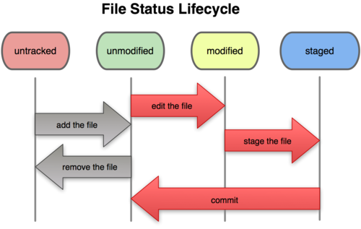
Lifecycle

Slide 9
Github – Social Coding
Web-based hosting service for software development projects
Launched in April 2008
For both personal and commercial use (personal use does not allow private projects)
On 16 January 2013, GitHub announced it had passed the 3 million users mark and now hosting more than 5 million repositories.

Slide 10
Let’s clone a project!
https://github.com/jlalande/webapp-demo
git clone https://github.com/jlalande/webapp-demo.git

Slide 11
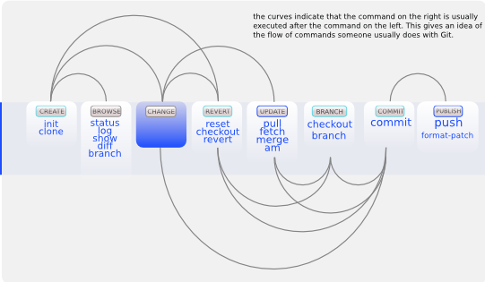
Workflow

Slide 12
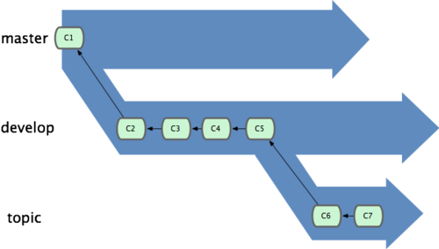
Branching Model

Slide 13
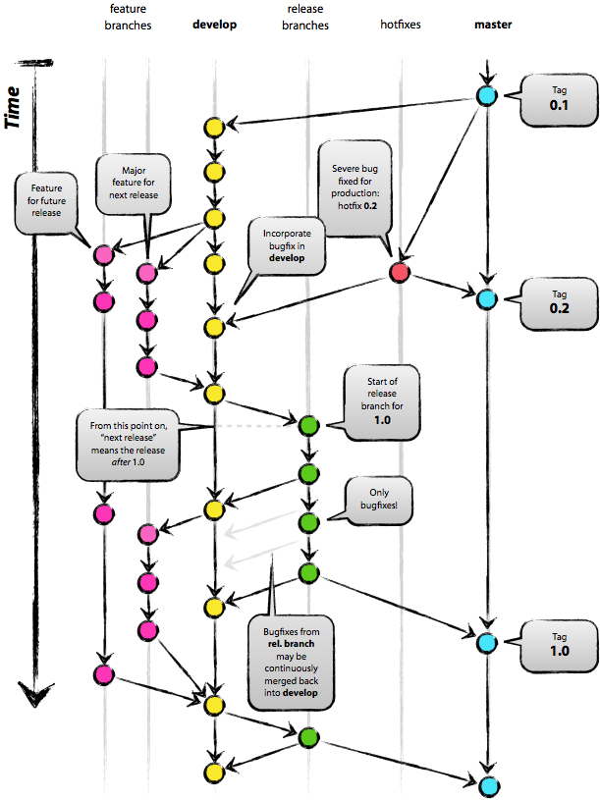

Slide 14
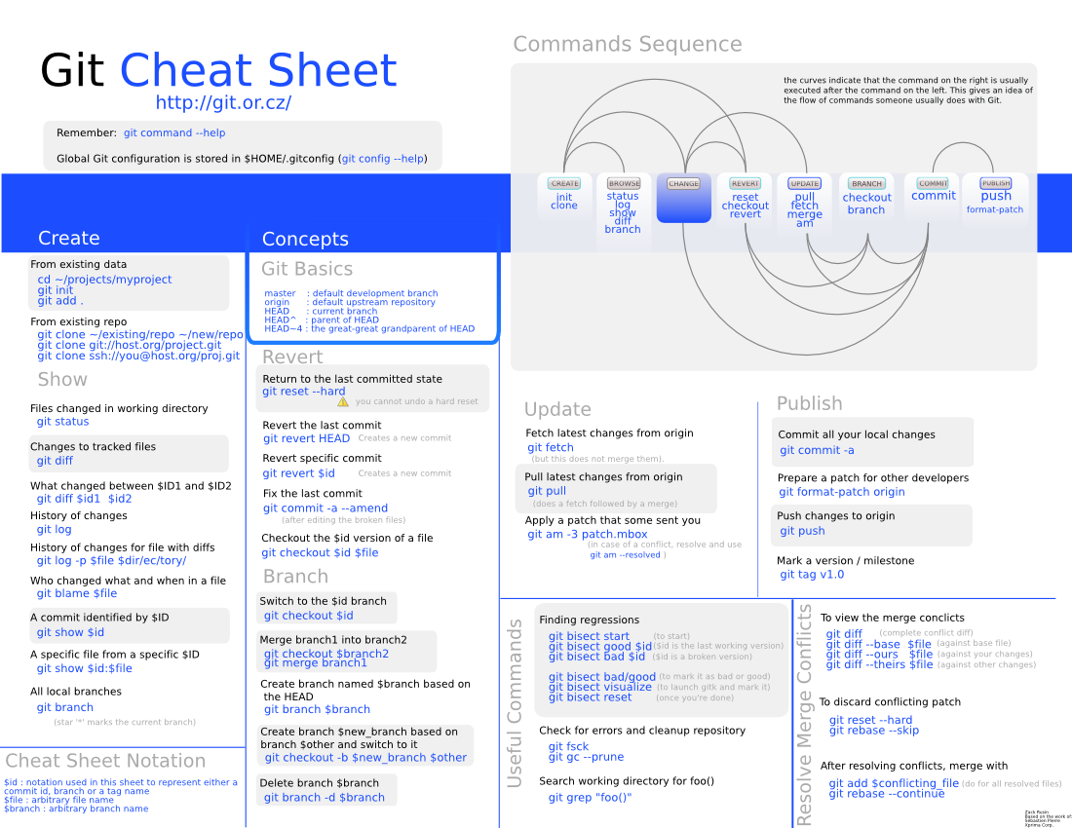

Slide 15
Références
http://git-scm.com/
http://github.com/
http://gitlab.org/
http://nvie.com/posts/a-successful-git-branching-model/
https://code.google.com/p/tortoisegit/
http://zrusin.blogspot.ca/2007/09/git-cheat-sheet.html

